Slide 1




GRADE 11 · ALGEBRA II · TOPIC 6
Lesson 6-3
Logarithms
Journey of 6 stations, 60 minutes
Exponential and Logarithmic Functions
Mr Malek Thiab
FAITH, RIGHTEOUSNESS AND WISDOM
Notes:
Speaker notes: Welcome to Lesson 6-3: Logarithms.
Timing: 60 minutes (Diagnose 6, Targeted Instruction 18, Practice 12, Production 12, Mastery Gate 6, Smart Production 6). For a 40-minute class scale every station by two thirds.
The journey map on the next slide shows the six stations; in slideshow mode the Morph transition zooms the station circles into the breadcrumb at the top of every later slide.

Slide 2


Today's journey
Six stations. Each one zooms in as we arrive.
Targeted Instruction
18 min
Production
12 min
Smart Production
6 min
2
4
6
1
3
5
Diagnose
6 min
Practice
12 min
Mastery Gate
6 min
FAITH, RIGHTEOUSNESS AND WISDOM
Notes:
Speaker notes: This is the whole map. Walk it left to right: Diagnose (what we already know), Targeted Instruction (A Logarithm Is an Exponent; Common and Natural Logarithms; Evaluating with Technology; Logarithms and Exponential Models), Practice (Practice, Apply, Investigate), Production (Red Sea Visitors: When Do We Reach 3 Million?), Mastery Gate (three questions to pass), Smart Production (create, then Time to Check).
In slideshow mode the Morph transition animates these circles shrinking into the breadcrumb on later slides; without Morph the slides fade.
Ask the class which station they think will be hardest.

Slide 3
What we are learning
OBJECTIVES
VOCABULARY
Understand and evaluate logarithms.
Analyze common logarithms and natural logarithms.
Convert between exponential and logarithmic forms.
Use logarithms to solve problems involving exponential models.
Evaluate logarithms using technology.
common logarithm
logarithm
logarithmic function
natural logarithm
order of magnitude
STANDARDS
HSF.BF.B.4.A Solve an equation of the form f(x) = c for a simple function f that has an inverse and write an expression for the inverse.
HSF.BF.B.5 Understand the inverse relationship between exponents and logarithms and use this relationship to solve problems involving logarithms and exponents.
HSF.LE.A.4 For exponential models, express as a logarithm the solution to ab^(ct) = d where a, c, and d are numbers and the base b is 2, 10, or e; evaluate the logarithm using technology.
ESSENTIAL QUESTION
How can we use logarithms and relate them to exponents?
MATHEMATICAL PRACTICES MP.2 · MP.5
HSF.BF.B.4.A · HSF.BF.B.5 · HSF.LE.A.4
FAITH, RIGHTEOUSNESS AND WISDOM
Mr Malek Thiab · 3
Notes:
Speaker notes: Read the objectives aloud one at a time and have students say which one they feel least sure about.
Vocabulary used today: common logarithm, logarithm, logarithmic function, natural logarithm, order of magnitude.
Standards are listed on this slide.

Slide 4


1
2
3
4
5
6
STATION 1 · DIAGNOSE · 6 MIN
Start here: three quick checks
1
2
3
Done when
Done when: all three are answered without a calculator, and for the last one you can name the two powers of 2 that trap the answer.
HSF.BF.B.4.A · HSF.BF.B.5 · HSF.LE.A.4
FAITH, RIGHTEOUSNESS AND WISDOM
Mr Malek Thiab · 4
Notes:
Speaker notes (Diagnose, 6 min, no calculator):
Answers: Q1 2^5 = 32. Q2 3^x = 81, and 3^4 = 81 so x = 4. Q3 2^4 = 16 and 2^5 = 32, and 20 sits between them, so x is between 4 and 5. Q3 is the hook for the lesson: no whole number works, and we need a new tool. Verbal misconceptions: Q1 students compute 2 x 5 = 10; Q2 students divide 81 by 3 = 27; Q3 students say x = 10 (20 divided by 2). Adaptive routing: if >30% miss Q1 or Q2, pause and rebuild the meaning of an exponent before slide 5 (use 2^1, 2^2, 2^3 on the board). If >30% miss Q3, that is expected: go straight to slide 5 block 1 and return to Q3 on slide 7. If everyone is secure, jump to the Investigate item on slide 9.

Slide 5




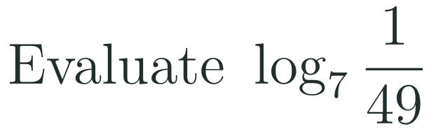

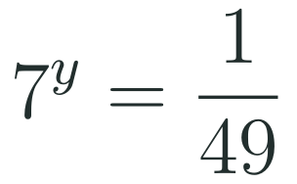



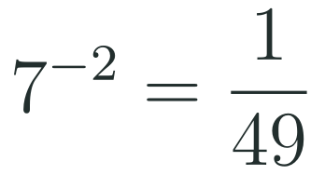
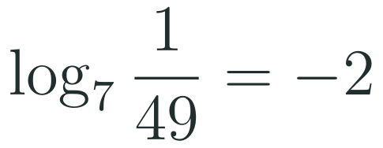
1
2
3
4
5
6
STATION 2 · TARGETED INSTRUCTION · 18 MIN
A Logarithm Is an Exponent
EXAMPLE A
EXAMPLE B
EXAMPLE C
HSF.BF.B.4.A · HSF.BF.B.5 · HSF.LE.A.4
FAITH, RIGHTEOUSNESS AND WISDOM
Mr Malek Thiab · 5
Notes:
Speaker notes (Targeted Instruction, block 1 of 4):
Worked solutions. Ex1: 3^4 = 81 -> base 3 stays the base, exponent 4 becomes the answer: log_3(81) = 4. Ex2: ask '2 to what power gives 32?'; 2^5 = 32 so log_2(32) = 5. Ex3: 7^(-2) = 1/49, so log_7(1/49) = -2 (a log can be negative; its argument cannot). Vocabulary: a logarithm is the exponent; the function f(x) = log_b(x) is called a logarithmic function, the inverse of b^x, and we graph it in Lesson 6-4. Domain: b > 0, b not 1, x > 0 because no power of a positive base gives zero or a negative number. Verbal misconceptions: 'cancel' the log and the base like factors; swap base and result and write log_81(3) = 4; believe a logarithm can never be negative. Adaptive routing: if >30% miss Gate Q1, return to this slide and redo Ex2 with a new number; if >30% hesitate on Ex3, show 7^(-1) and 7^(-2) first, then 7^0 = 1 so log_7(1) = 0.

Slide 6






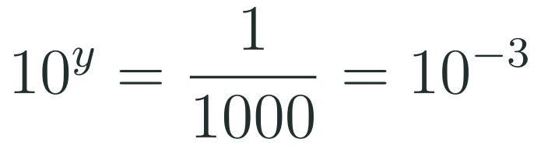




1
2
3
4
5
6
STATION 2 · TARGETED INSTRUCTION · 18 MIN
Common and Natural Logarithms
EXAMPLE A
EXAMPLE B
EXAMPLE C
HSF.BF.B.4.A · HSF.BF.B.5 · HSF.LE.A.4
FAITH, RIGHTEOUSNESS AND WISDOM
Mr Malek Thiab · 6
Notes:
Speaker notes (Targeted Instruction, block 2 of 4):
Worked solutions. Ex1: log means base 10, 10^3 = 1000 so log 1000 = 3 (count the zeros). Ex2: 0.001 = 1/1000 = 10^(-3) so log 0.001 = -3. Ex3: ln means base e; e^y = e^5 gives y = 5, so ln(e^5) = 5 (the log and the exponential undo each other). Say aloud: the common logarithm has no base written and means base 10; the natural logarithm is written ln and means base e. Verbal misconceptions: 'log with no base means base e' (confusing log with ln); log 1000 = 1000/10 = 100; ln e^5 = 5e. Adaptive routing: if >30% give base e for log, redo Ex1 with the calculator LOG key and compare with LN on slide 7; if >30% miss Ex3, write e^y = e^5 on the board and ask 'e to what power gives e^5?'. Gate Q2 routes here (slide 6).

Slide 7

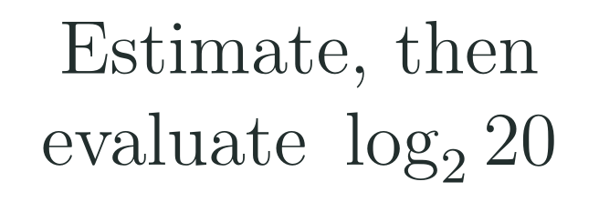
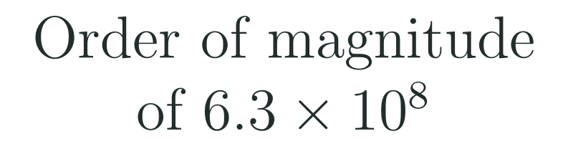







1
2
3
4
5
6
STATION 2 · TARGETED INSTRUCTION · 18 MIN
Evaluating with Technology
EXAMPLE A
EXAMPLE B
EXAMPLE C
HSF.BF.B.4.A · HSF.BF.B.5 · HSF.LE.A.4
FAITH, RIGHTEOUSNESS AND WISDOM
Mr Malek Thiab · 7
Notes:
Speaker notes (Targeted Instruction, block 3 of 4):
Worked solutions. Ex1: calculator LOG gives 1.69897 -> 1.699; LN gives 3.91202 -> 3.912; they differ because the bases differ (10 vs e). Ex2: 2^4 = 16 < 20 < 2^5 = 32, so log_2(20) lies between 4 and 5 (this answers diagnostic Q3); a graphing calculator or the log(base, x) key gives 4.3219 -> 4.322; always estimate first to catch keying errors. Ex3: log(6.3 x 10^8) = 8.799 -> rounds to 9, so the order of magnitude is 10^9 (the number has 9 digits). Verbal misconceptions: students type log(2)(20) or log 20 / 2; students think log 50 and ln 50 must match because 'both are logs of 50'; students report 8.8 as the order of magnitude instead of rounding to the integer. Adaptive routing: if >30% cannot place log_2(20) between 4 and 5, go back to slide 5 Ex2 and list 2^1 to 2^6; if >30% miss the rounding in Ex3, ask 'how many digits?'. Gate Q1 routes to slide 5 and Q2 to slide 6.

Slide 8










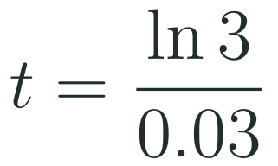


1
2
3
4
5
6
STATION 2 · TARGETED INSTRUCTION · 18 MIN
Logarithms and Exponential Models
EXAMPLE A
EXAMPLE B
EXAMPLE C
HSF.BF.B.4.A · HSF.BF.B.5 · HSF.LE.A.4
FAITH, RIGHTEOUSNESS AND WISDOM
Mr Malek Thiab · 8
Notes:
Speaker notes (Targeted Instruction, block 4 of 4):
Worked solutions. Ex1: divide by 5 FIRST: 2^t = 8, convert: t = log_2(8) = 3. Check 5 x 2^3 = 40. Ex2: divide by 1000: 1.05^t = 2; convert: t = log_{1.05}(2) = ln2/ln1.05 = 14.2067 -> 14.2 years (model values). Check 1000 x 1.05^14.2 is about 2000. Ex3: divide by 200: e^(0.03t) = 3; take ln of both sides (ln and e undo each other): 0.03t = ln 3 = 1.0986; t = 1.0986/0.03 = 36.62 -> 36.6. Link to HSF.LE.A.4: solutions of ab^(ct) = d are written as a logarithm and evaluated with technology. Verbal misconceptions: students divide 40 by 2 or subtract 2 instead of isolating the power; students take the log before dividing by 5 and write log(5 x 2^t) = 5 log(2^t) wrongly; students write t = ln3 / 0.03 as ln(3/0.03). Adaptive routing: if >30% miss Gate Q3, return to this slide, redo Ex2 and insist on 'isolate, then convert'; if >30% cannot finish Ex3, practice with base 10 first (10^t = 50). Gate Q3 routes here (slide 8).

Slide 9


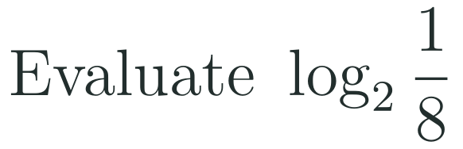
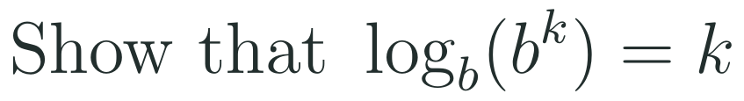

1
2
3
4
5
6
STATION 3 · PRACTICE · 12 MIN
Give it a go: Practice, Apply, Investigate
PRACTICE
APPLY
INVESTIGATE
Secure the method
Use it in context
Find out why
Done when: each answer is checked by rewriting it in exponential form.
Done when: the equation is set up before using a calculator, and the answer states units (years).
Done when: your argument uses what a logarithm means, not only that the calculator gives an error.
HSF.BF.B.4.A · HSF.BF.B.5 · HSF.LE.A.4
FAITH, RIGHTEOUSNESS AND WISDOM
Mr Malek Thiab · 9
Notes:
Speaker notes (Practice, 12 min; tierless differentiation: students choose the starting column and may move across):
Answers. Practice: 4^3 = 64 gives log_4(64) = 3. log_2(1/8): 2^(-3) = 1/8 so the answer is -3. Apply (model values for a Jeddah desalination storage tank, 6000 m3 growing 18% a year): 6000(1.18)^t = 50000 -> 1.18^t = 25/3 = 8.333 -> t = log_{1.18}(8.333) = ln(8.333)/ln(1.18) = 12.81 -> 12.8 years. Investigate: no power of a positive base gives 0 or a negative number, so b^y = x has no solution when x <= 0; and b^k = b^k means the exponent needed to reach b^k is k, so log_b(b^k) = k. Verbal misconceptions: students write log_4(3) = 64 (swapped roles); students divide 50000 by 6000 and call 8.3 the answer; students say log of a negative is 'negative infinity'. Adaptive routing: if >30% miss Practice item 1, route to slide 5 block 1; if >30% cannot set up the Apply equation, route to slide 8 block 4 Ex2; if Investigate is secure early, pose: what is log_b(1) for every base?

Slide 10
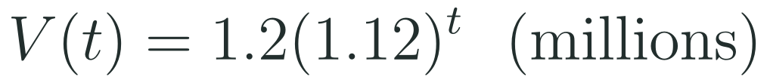
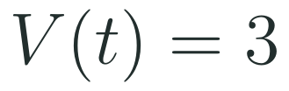
1
2
3
4
5
6
STATION 4 · PRODUCTION · 12 MIN
Production: Red Sea Visitors: When Do We Reach 3 Million?
THE MODEL
DONE WHEN
A Red Sea destination under Vision 2030 plans for growth in yearly visitors. In this model, the destination welcomed 1.2 million visitors in the base year 2026 and visitor numbers grow by 12 percent every year. All numbers are model values, not official statistics. Time t is measured in years after 2026.
The exponential term is isolated before any logarithm is taken.
The exact logarithm answer is written before the decimal.
The answer is checked by substituting back into the model.
The conclusion names units and the year, and says it is a model value.
Write the equation to be solved for t and isolate the exponential term.
Use a logarithm to write the exact solution, then evaluate it to one decimal place.
Check by substitution, state the calendar year, and explain why dividing 3 by 1.2 does not answer the question.
Hint for solving: divide both sides by 1.2 first. Then ask: 1.12 to what power gives 2.5?
HSF.BF.B.4.A · HSF.BF.B.5 · HSF.LE.A.4
FAITH, RIGHTEOUSNESS AND WISDOM
Mr Malek Thiab · 10
Notes:
Speaker notes (Production, 12 min):
Full solution (model values). Equation: 1.2(1.12)^t = 3. Isolate: 1.12^t = 3/1.2 = 2.5. Convert: t = log_{1.12}(2.5) = ln(2.5)/ln(1.12) = 0.91629/0.11333 = 8.085 -> 8.1 years. Check: 1.2 x 1.12^8.085 = 3.000 million. Year: 2026 + 8.1 = early 2034 in the model. Dividing 3 by 1.2 gives only the growth ratio 2.5, not how many yearly 12 percent increases produce it; the logarithm counts the years. Extension if time: doubling time = ln2/ln1.12 = 6.1 years. Verbal misconceptions: 'divide by 1.12 each time' or 't = 2.5 / 1.12 = 2.2 years'; students round the logarithm early; students forget that t counts years after 2026. Adaptive routing: if >30% cannot isolate 1.12^t, route to slide 8 block 4 Ex1; if the exact form is missing, route to slide 5 block 1 conversion; if >30% finish early, ask for the year when the model reaches 6 million (t = ln5/ln1.12 = 14.2).

Slide 11
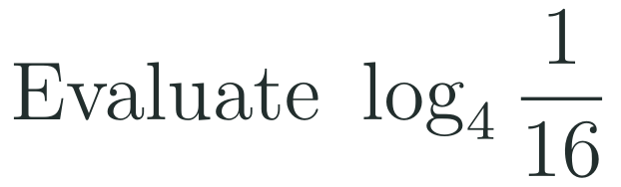

1
2
3
4
5
6
STATION 5 · MASTERY GATE · 6 MIN
Mastery Gate: three questions to pass
1
2
3
Pass mark
3 of 3 correct unlocks Station 6. Fewer than that: return to the slide for the question you missed, redo it, then re-take the gate.
HSF.BF.B.4.A · HSF.BF.B.5 · HSF.LE.A.4
FAITH, RIGHTEOUSNESS AND WISDOM
Mr Malek Thiab · 11
Notes:
Speaker notes (Mastery Gate, 6 min, no calculator):
Answers. Q1: 4^(-2) = 1/16 so the answer is -2. Q2: ln(e^3) = 3 and log 100 = 2, sum = 5. Q3: 1.04^t = 3 -> t = ln3/ln1.04 = 28.01 -> 28.0. Pass = all three correct (or Q1-Q2 correct with a correct set-up for Q3). Common wrong answers: Q1 4 or 1/2 or -4; Q2 3e + 2 or 6 (treating ln as multiplication); Q3 3/1.04 = 2.88, or t = 1500/500 = 3. Verbal misconceptions: swapping base and argument, treating log as a factor, taking the log before dividing. Adaptive routing: Q1 missed -> slide 5 block 1; Q2 missed -> slide 6 block 2 (and slide 7 for technology); Q3 missed -> slide 8 block 4. If >30% miss Q1, reteach block 1 with a fresh example before continuing; if >30% miss Q3, shorten Smart Production and carry it into the next session; never cut the gate.

Slide 12


1
2
3
4
5
6
STATION 6 · SMART PRODUCTION · 6 MIN
Smart Production: make one, then check it
CREATE
TIME TO CHECK
Design a one-slide model for a Saudi growth or decay situation of your own (label every number as a model value).
Show the equation, the isolated exponential, the exact logarithm answer and the decimal with units.
Add one NON-example: dividing the two values and stopping, with a caption saying what that shortcut actually computes.
Exit ticket: write your answer on a sticky note and place it on the door.
Done when: your slide is checked by substitution and a partner can follow it without you.
Next lesson: 6-4 Logarithmic Functions.
HSF.BF.B.4.A · HSF.BF.B.5 · HSF.LE.A.4
FAITH, RIGHTEOUSNESS AND WISDOM
Mr Malek Thiab · 12
Notes:
Speaker notes (Smart Production, 6 min):
Exit ticket solution: divide by 120: e^(0.05t) = 3; take ln: 0.05t = ln 3; t = ln3/0.05 = 1.0986/0.05 = 21.97 -> 22.0. Check: 120 e^(1.0986) = 120 x 3 = 360. Verbal misconceptions: writing t = ln(3/0.05); forgetting to divide by 120 first; reporting 21.9 by truncating. Adaptive routing: if >30% miss the exit ticket, open the next lesson with slide 8 block 4 Ex3; strong students may extend to compare doubling times of two growth rates. If time runs short, carry Smart Production into the next session.

Slide 13
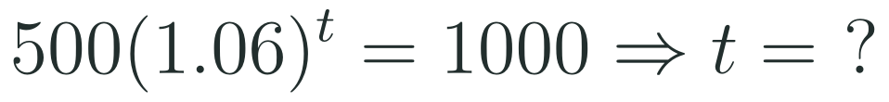


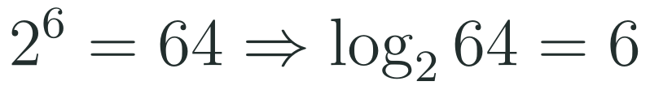


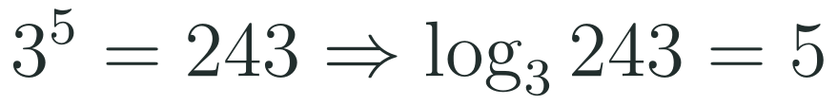


Exam connections
SAT
GAT
SAAT
STEPS
STEPS
STEPS
1
1
1
2
2
2
3
HSF.BF.B.4.A · HSF.BF.B.5 · HSF.LE.A.4
FAITH, RIGHTEOUSNESS AND WISDOM
Mr Malek Thiab · 13
Notes:
Speaker notes: each exam item is worked in numbered steps.
SAT (Advanced Math, calculator allowed): 500(1.06)^t = 1000; divide by 500: 1.06^t = 2; t = log_{1.06}(2) = ln2/ln1.06 = 11.9. Answer choices would typically include log_{1.06}(1000) (trap: skipped dividing by 500), log_2(1.06) (trap: base and argument swapped) and 2/1.06 (trap: treating t as a factor). GAT/Qudurat (quantitative comparison, no calculator, about 75 seconds): 2^6 = 64 so A = 6; 3^5 = 243 so B = 5; A is greater. Trap: choosing B because 243 > 64; the base decides the exponent, not the size of the number. SAAT/Tahsili (four options, no calculator): log_4(x) = 3 gives x = 64; log_2(64) = 6. Trap: answering 3 (assuming the base does not matter), 12 (4 x 3) or 1.5 (halving). Verbal misconceptions: comparing arguments instead of exponents; swapping base and result. Adaptive routing: if >30% miss the SAT item, return to slide 8 block 4; if >30% miss the GAT item, return to slide 5 block 1 Ex2; if >30% miss the SAAT item, return to slide 5 and rehearse find-x-first.

Slide 14
Journey complete
Targeted Instruction
Production
Smart Production
✓
✓
✓
✓
✓
✓
Diagnose
Practice
Mastery Gate
A logarithm is an exponent: convert, evaluate with LOG or LN, and use it to find time in exponential models.
FAITH, RIGHTEOUSNESS AND WISDOM
Notes:
Speaker notes: Every station is checked off. Recap in one sentence: A logarithm is an exponent: convert, evaluate with LOG or LN, and use it to find time in exponential models. Collect the Time to Check responses. Next lesson: 6-4 Logarithmic Functions.

